Slide 1
Airbnb Reviews Sentiment Analysis
Felipe Rodriguez
Notes:
Welcome everyone to the Airbnb Review Sentiment Analysis presentation

Slide 2
Agenda
Project Overview
Data Overview
Methods and Analysis
Challenges
Findings
Implementation
Summary
Notes:
This is the agenda for today.. We are going to be talking about..

Slide 3
Project Overview
Understand the sentiment in different reviews
Build a model to predict sentiment
Understand the reviews in the dataset
Notes:
The goal of this project is to..
Understand the sentiment of reviews provided by users.
By using sentiment, a model can be used to predict the sentiment of future reviews.
Additionally, understanding the reviews will give insight to listings and their performance.

Slide 4
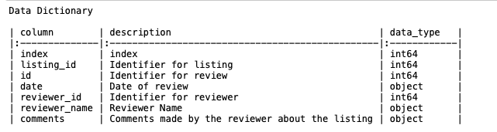
Data Overview
Reviews and reviewers for various listings
Kaggle – Airbnb
Boston Data
Notes:
The data contains..
It is sourced from.. airbnb
And includes the following fields…
This project will analyze sentiment for the reviews in the boston area

Slide 5
Methods and Analysis
Stop Words Removed
Punctuations Removed
Naïve Bayes Model
Notes:
Two models were created and were split 80/20 into a testing and training data set.
Additionally, we created an ROC Curve and classification report to understand the results

Slide 6
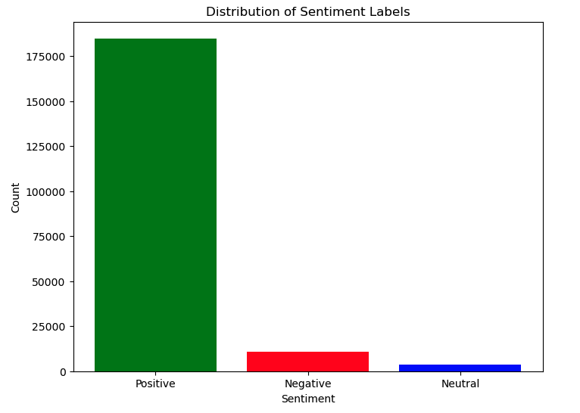
Findings
Mostly Positive Reviews
Notes:
Here we can see what types of sentiments are contained in the data

Slide 7
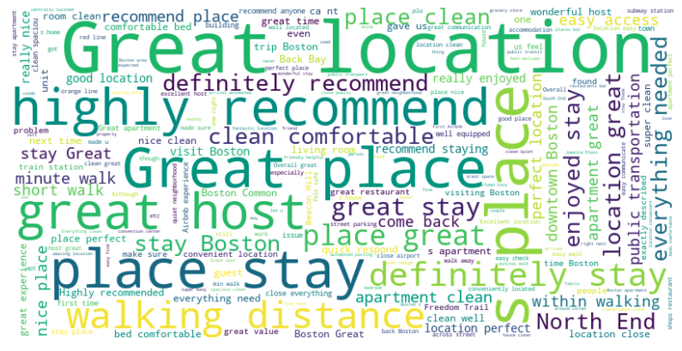
Findings
Many common Words
Mostly Positive
Notes:
Here are some of the common words
Things like great location, great place, and highly recommend stand out.

Slide 8
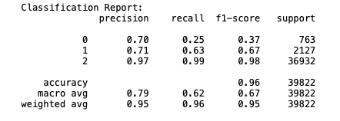
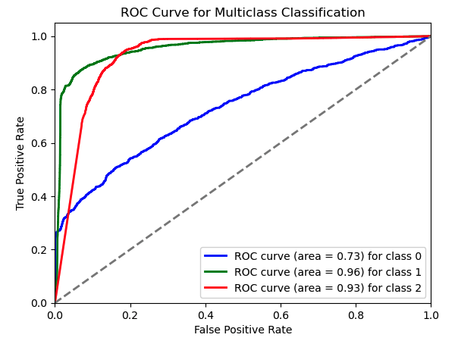
Findings
Model Performed Well
Classification report
F-1 Scores high for class 1, low for other two
ROC CURVE
Great At distinguishing class 1 and 2
Improving 0 would result in better model performance
Notes:
F-1 score is very high for classifier two – positive
The other two f-1 scores can be improved…
ROC curve...

Slide 9

Challenges
Successfully removing stop words and punctuation
Model features uses incorrectly at first – 100% accuracy
Vectorizing comments key element in model performance

Slide 10

Implementation
Web App
StreamLit
API to connect to model
User inputs review to determine sentiment

Slide 11
Summary
Naïve Bayes model
Performed very well
Findings
Mostly Positive Reviews
More Types of reviews will generate better Results
Implementation Plan
Awaiting Approval
Recommendation
Deploy model for use

